Slide 1
Name | Cameron
Git Hash | b95e116dcbbc8117df475227d584a34f80b44741
Sprint number | Start date | end date | Work hard rating
5 | 13/6/2022 | 24/6/2022 | 3/5

Slide 2
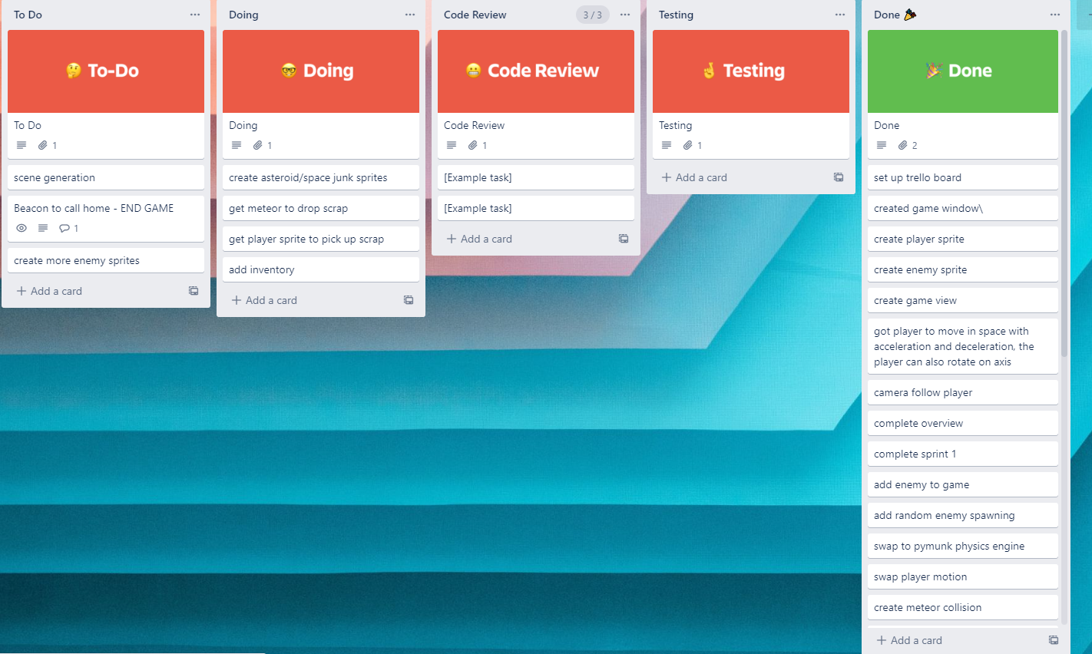
KANBAN board at the start of the sprint

Slide 3
Screenshot of the game at the start of the sprint

Slide 4
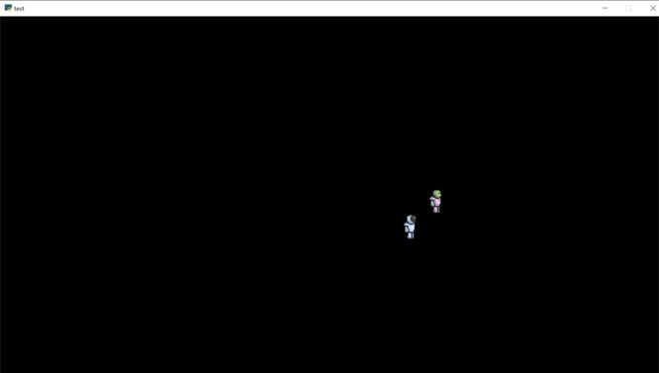
Screenshot of the game at the start of the sprint

Slide 5
Sprint Reflection and summary
I finished the AI with physics engine in game and there is very little problems with it interacting with everything else in game
I am very happy with the work i did but there was a lot of annoying bugs

Slide 6
Briefly describe other team members contributions
James created 2 lasers. One collided with enemies and applied a force the other is meant to be a mining laser but it doesn't work

Slide 7
Major Changes and Achievements Described
A mining laser which will send a steady stream of lasers and stop at a meteor which is accessed by pressing 2 and left mouse click
A bullet which knocks enemies back which is accessed by pressing 1 and than pressing mouse click
Enemies will move in game with the ai tested and the physics engine and will collide with other objects

Slide 8
Brief Description of your testing
The laser was tested by firing it at a meteor and seeing how it collided with it
The bullet was tested by firing it at meteors and seeing how the knockback would effect them
The enemy was already tested a lot so i added it to the game and checked for error codes. Due to the enemy using player variables the variables needed little tweaking

Slide 9
Link to testing results/tables

Slide 10
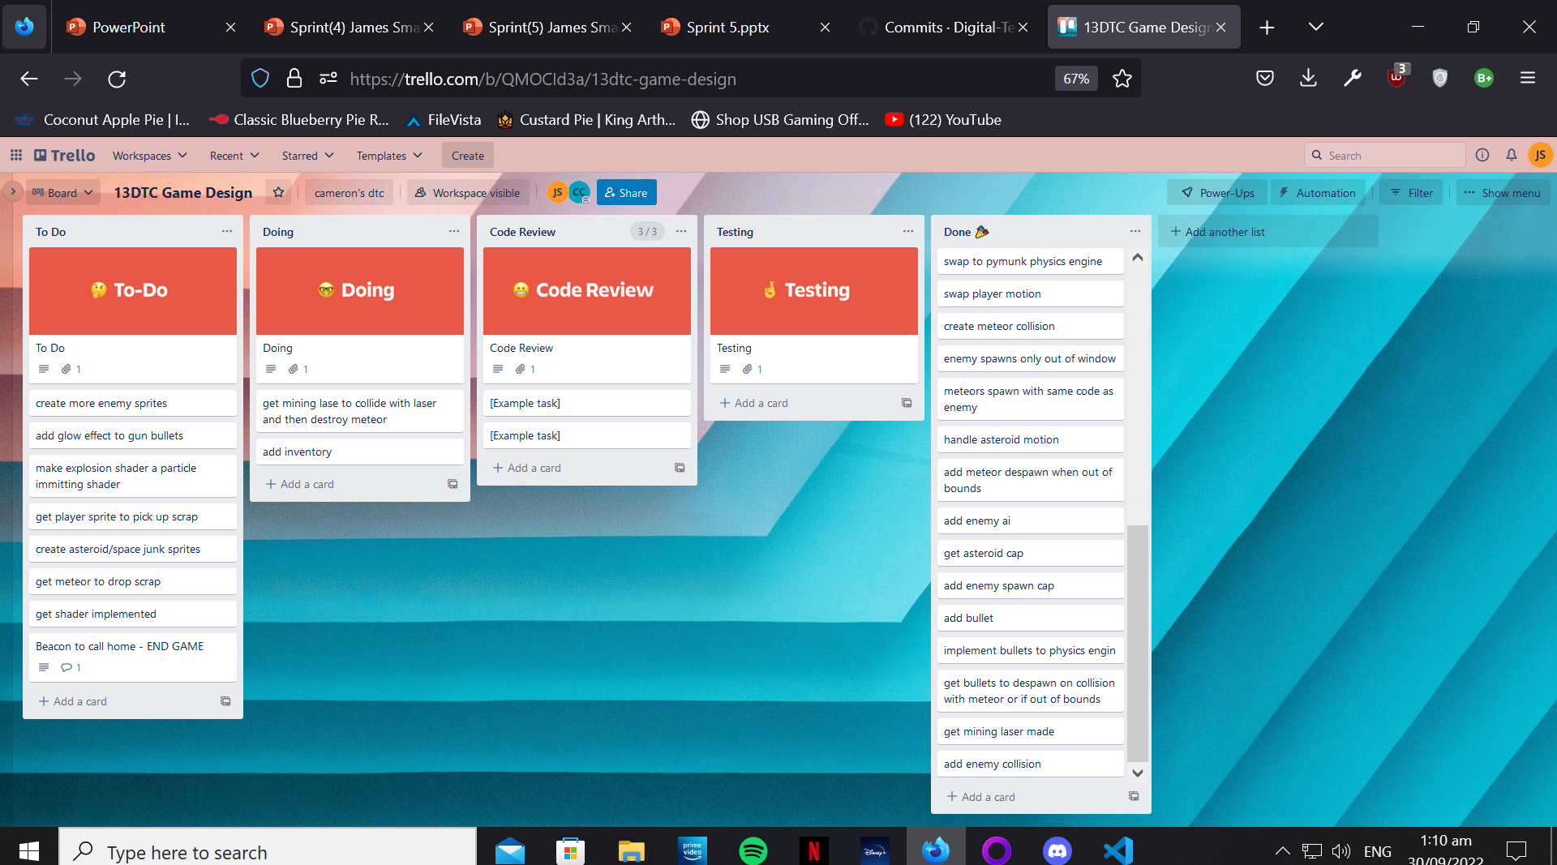
KANBAN board at the end of the sprint

Slide 11
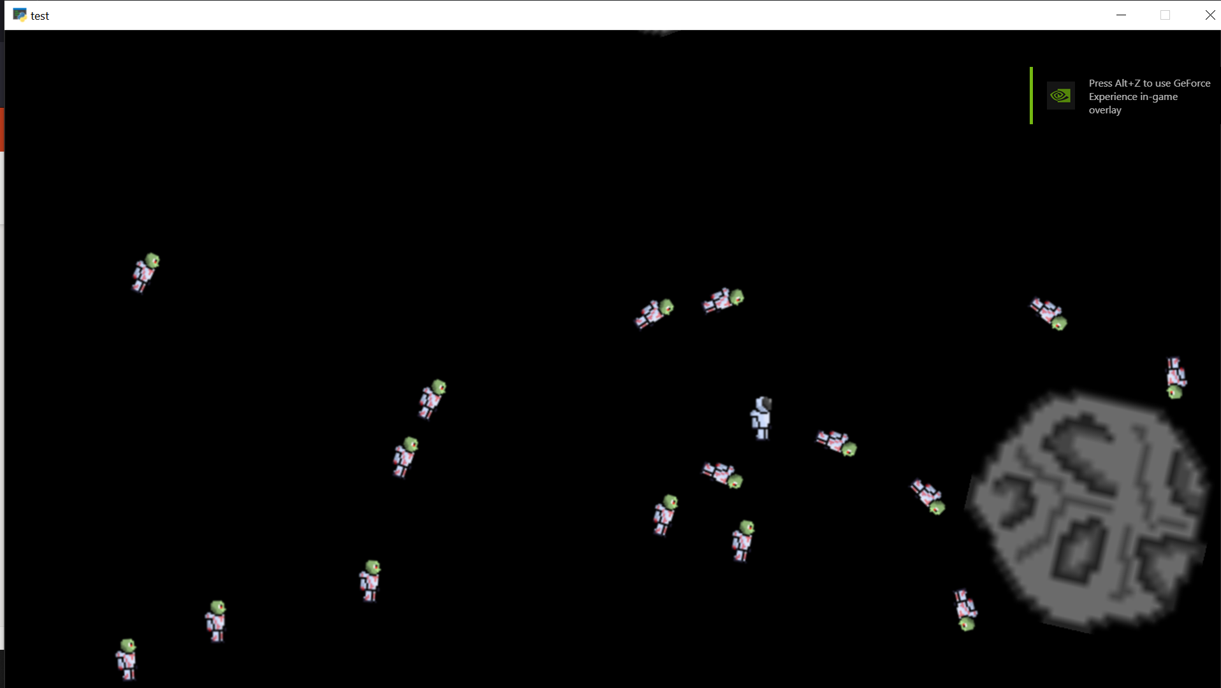
Screenshot of the game at the end of the sprint

Slide 12
Video of the game at the end of the sprint

Slide 13
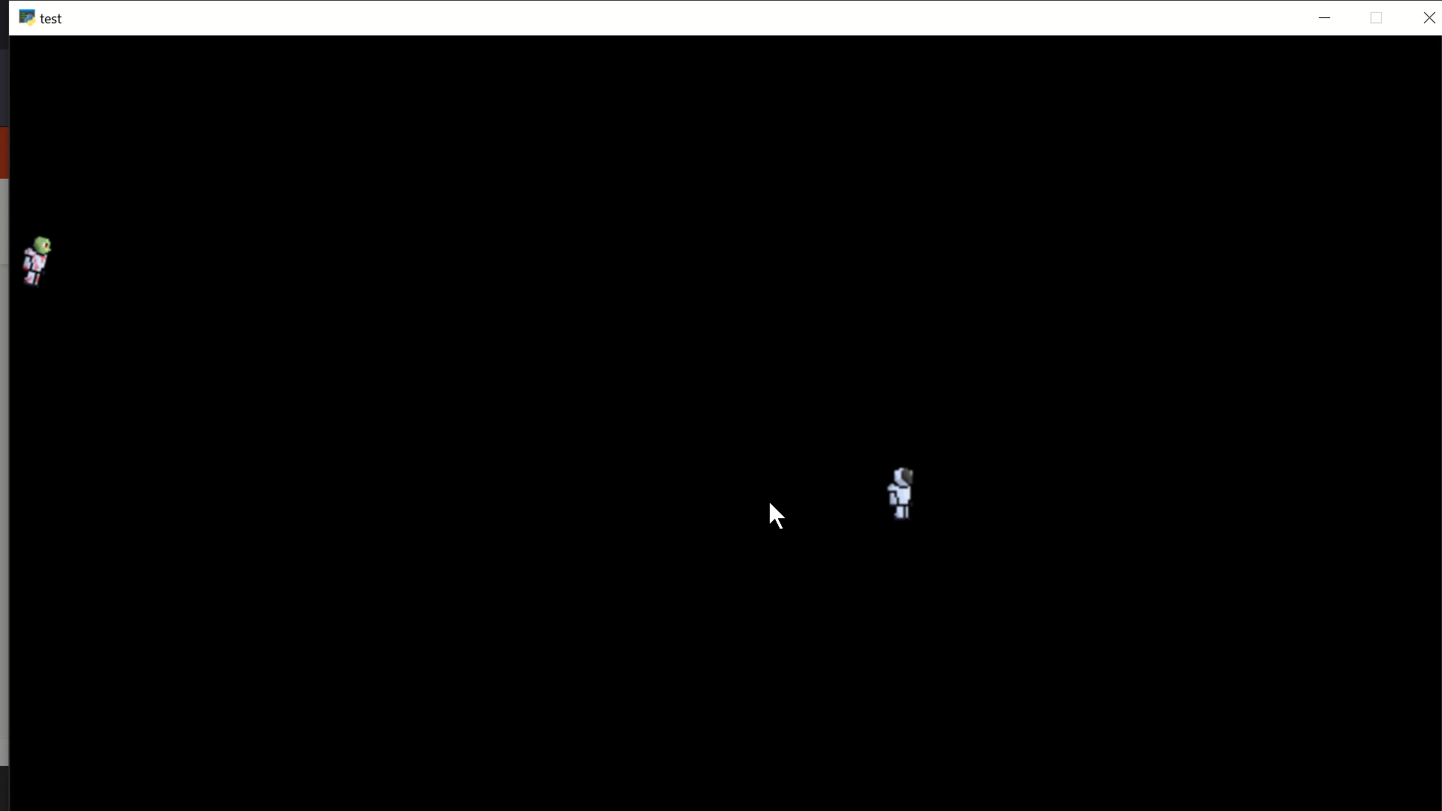
Video of the game at the end of the sprint

Slide 14
Notes for next time, future improvements
I was very happy with this sprint and have gotten all my jobs done for now so next sprint i will do some bug fixes and talk to james to find my next job

